Slide 1

Use Case 2
Artificial Intelligence
June 30, 2025
By: Cesar Anguiano, Lesly Jimenez

Slide 2

Index
The Dataset | 04
EDA | 05
Feature Transformation | 06
Modeling Approach | 07
Results | 08

Slide 3
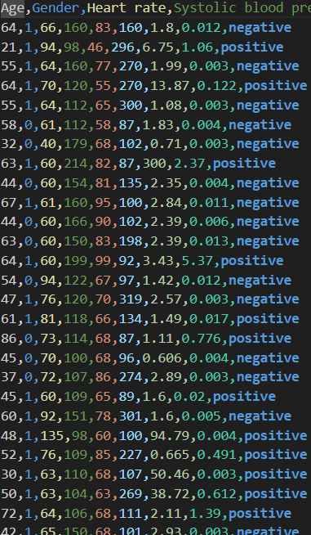

Heart Attack Dataset
The Dataset
Heart Attack
Features
Target
It has 8 features:
Age
Gender
Heart rate
Systolic blood pressure
Diastolic blood pressure
Blood sugar
CK-MB (Creatine Kinase-MB)
Troponin
it has 1 target variable
Result
Key Stats
Rows: 1,319 patient records
Columns: 9
03

Slide 4
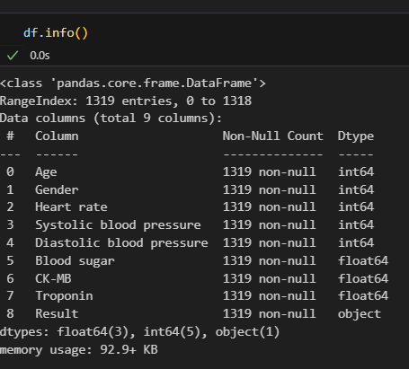
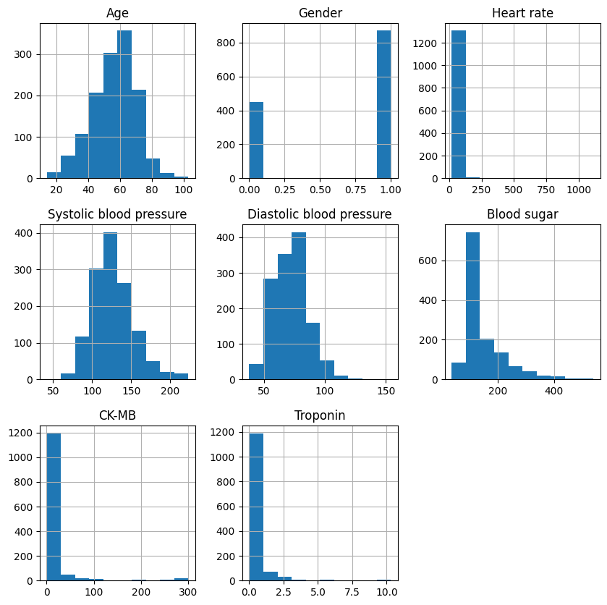
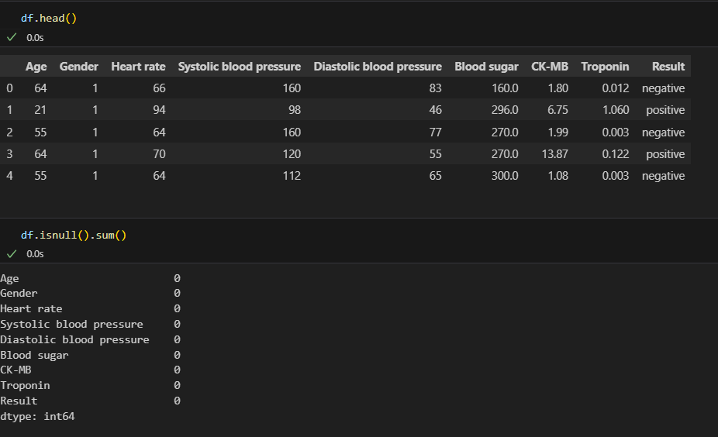

03

Slide 5


Exploratory Data Analysis
(EDA)
Exploratory Data Analysis
(EDA)
05

Slide 6
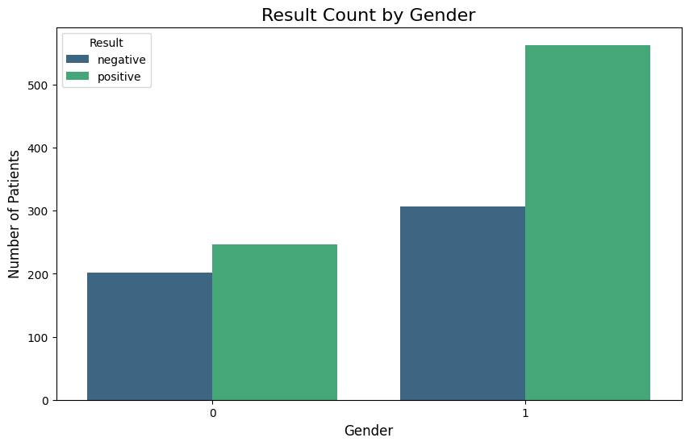
03

Slide 7
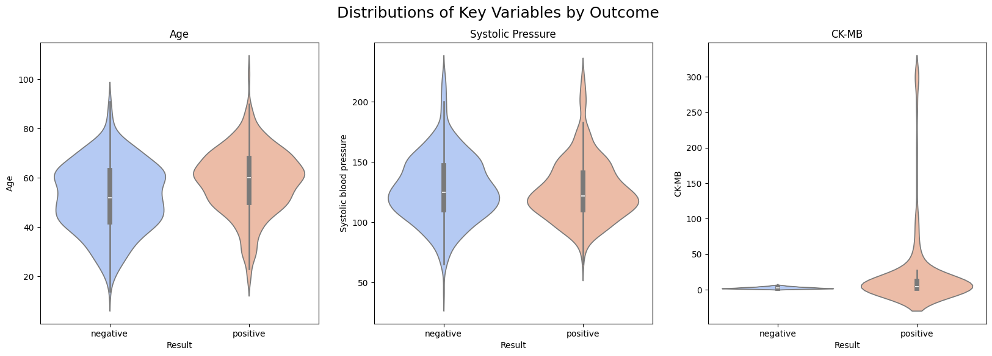
03

Slide 8
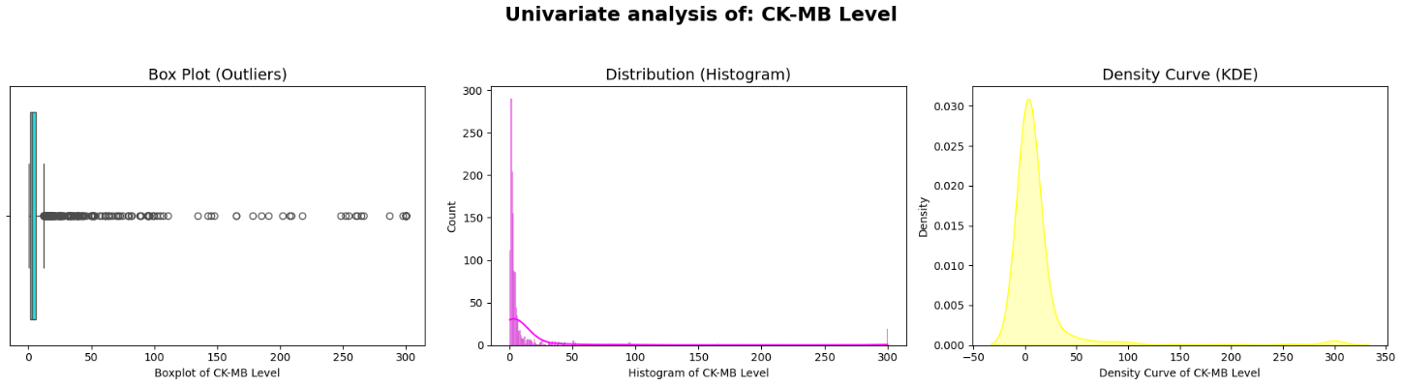

03

Slide 9
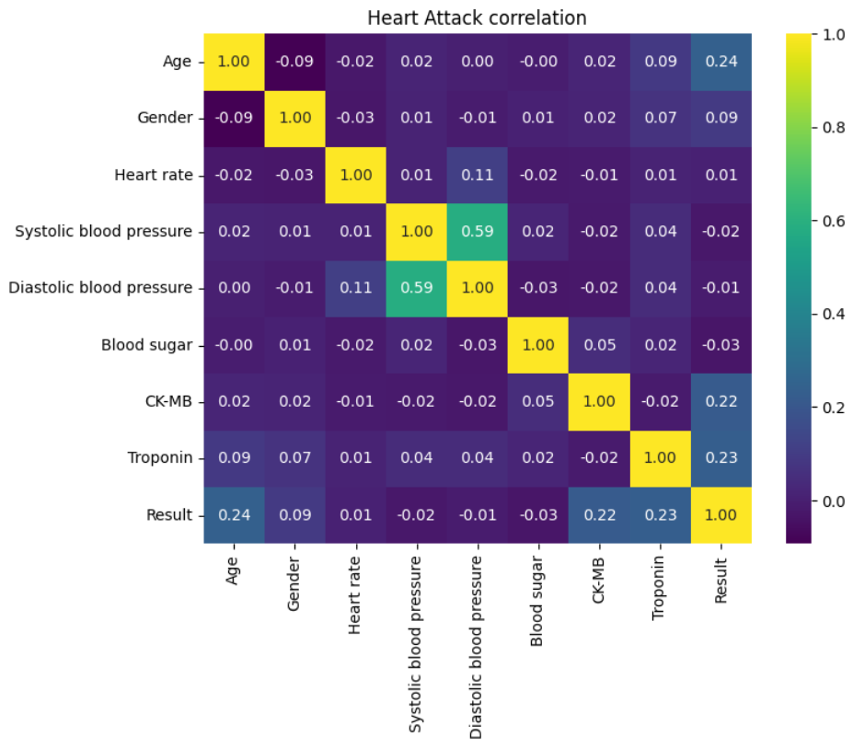
03

Slide 10
Feature Transformation
Feature Transformation
05

Slide 11

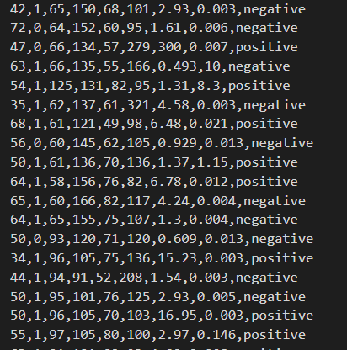
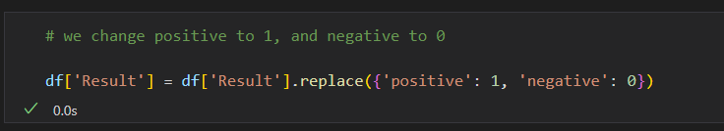

Feature Transformation
Change positive and negative to 1 and 0
Numerical values
04

Slide 12
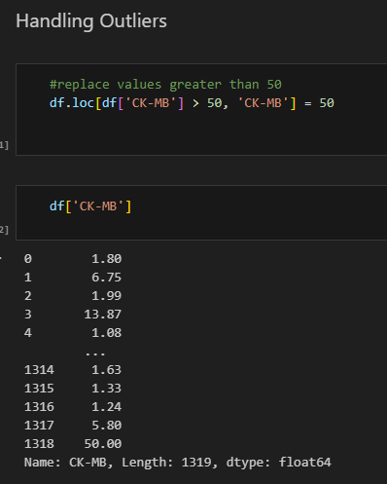
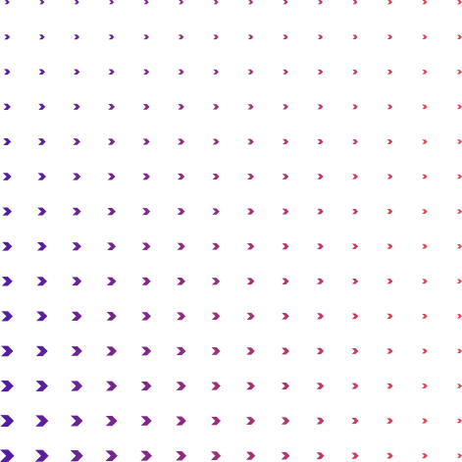
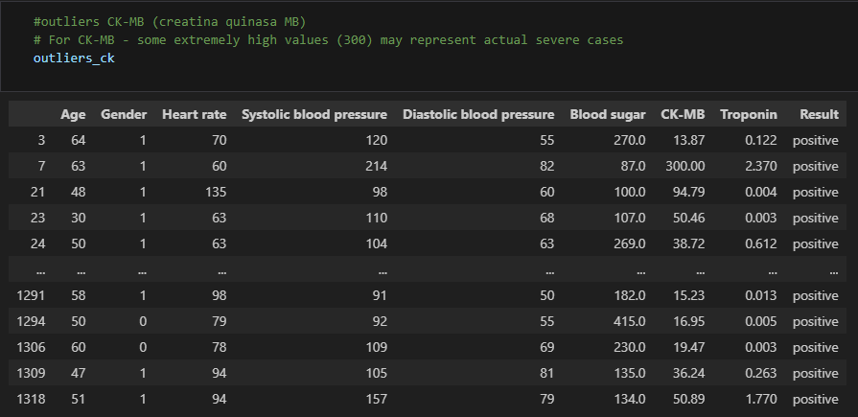
Outliers
06

Slide 13
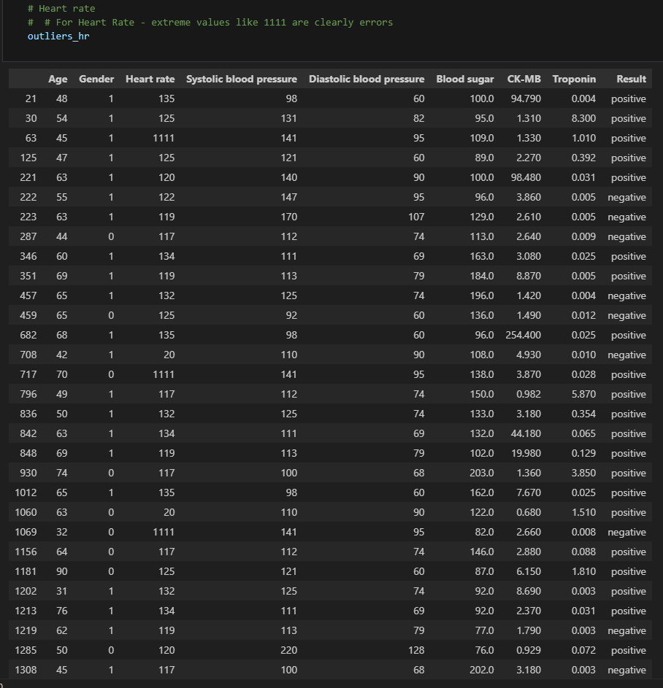
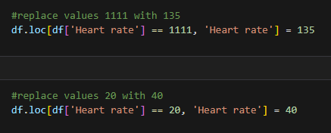
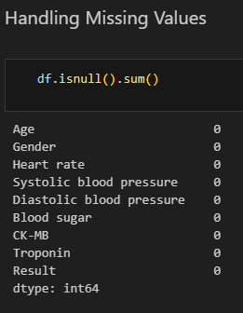
Replace
08

Slide 14
Modeling Approach
Modeling Approach
05

Slide 15

Used Models
Decision Tree model implementation with hyperparameter tuning
Logistic Regression
We decided that we used three models that worked best in the last practices we had.
This model caught my attention because of its visual and intuitive logic. I was interested to see in practice how a model based on clear and simple rules could classify the data.
I chose it because it's one of the fundamental algorithms for classification that we learned. I wanted to put this essential technique into practice to establish a solid baseline for comparison and see how a linear model performed against the others.
Random Forest with Hyperparameter Tuning
I found the concept of ensemble models to be especially powerful. I was curious to apply this advanced technique to see how combining many trees could achieve a superior and more robust performance.
07

Slide 16
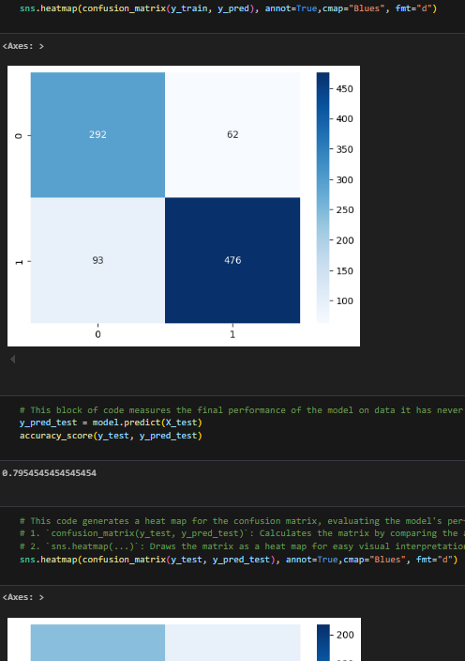
Model comparision
Here is how the three models performed on the training and testing data.
Model | Training Accuracy | Test Accuracy
Decision Tree | 99% | 98%
Random Forest | 100% | 97%
Logistic Regression | 83% | 79%
06

Slide 17
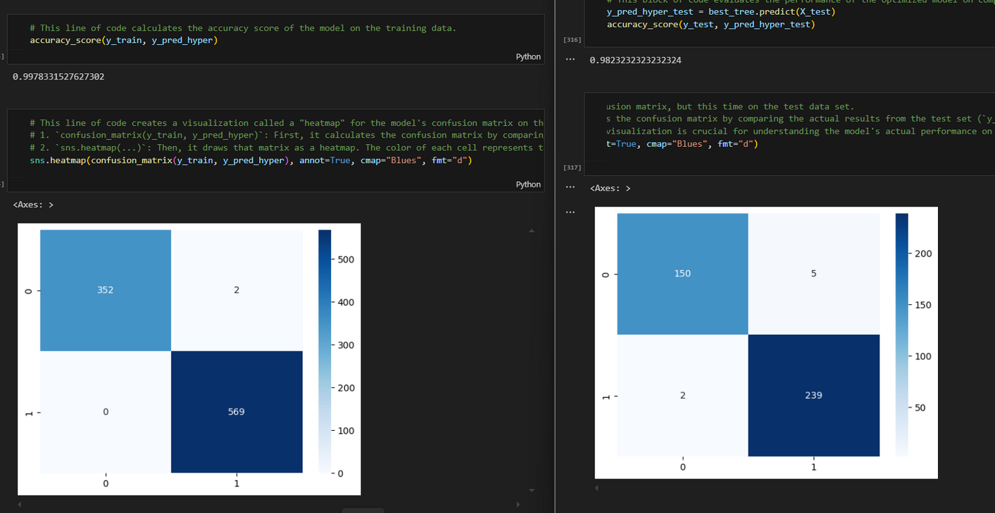
The winning model: Decision Tree
Based on the results, the Decision Tree is the best-performing model.
While the Random Forest achieved a perfect score on the training data, its test score was slightly lower than the Decision Tree's. The 100% training score is a sign of overfitting, meaning it memorized the training data too well and didn't generalize as perfectly to new, unseen data.
06

Slide 18
Questions?

Slide 19

TYSM!
GITHUB:
git@github.com:LeslyEJB/Use-Case-II.git

